Slide 1
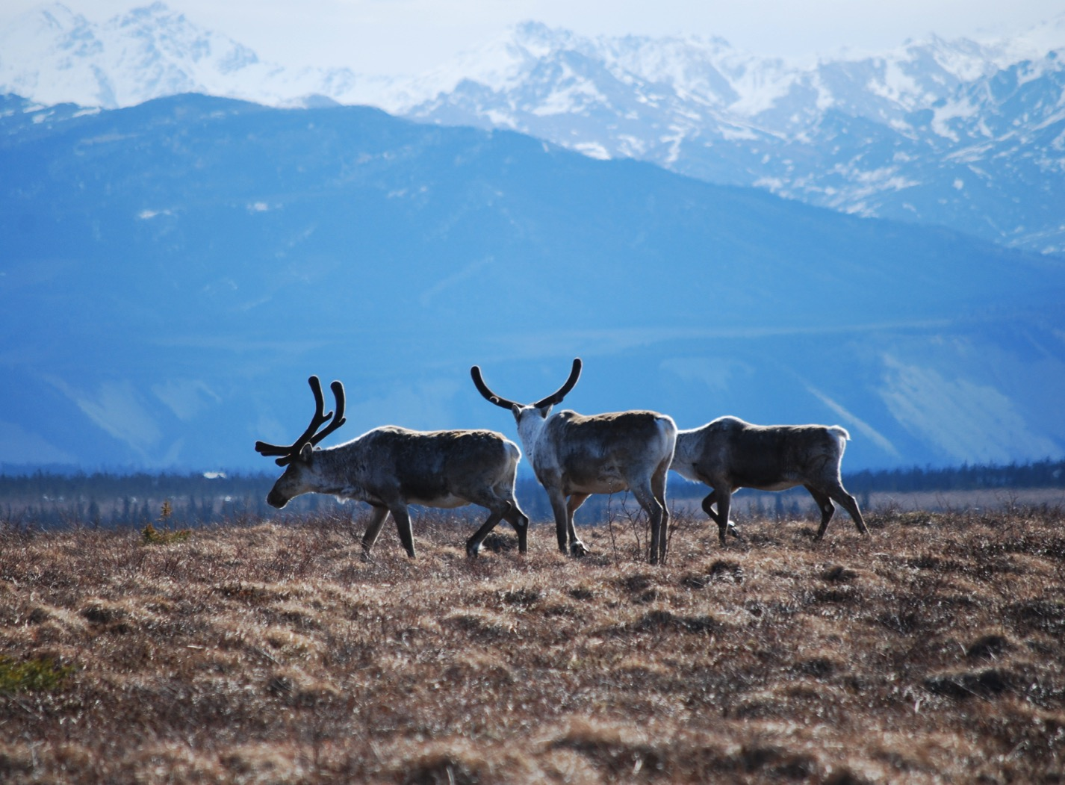
Arctic Boreal Vulnerability Experiment (ABoVE)
2017 ABoVE Airborne Campaign
9 June 2017 (DOY 160)
ATM-C: Nome – North Slope – Fairbanks
Charles Miller, Deputy Science Lead
Jet Propulsion Laboratory, California Institute of Technology
and the ABoVE Science Team For Hank Margolis, Eric Kasichke, Bruce Tagg
NASA HQ
Summer 2017

Slide 2
9 June 2017/DOY 160 Nome – North Slope – Fairbanks
Assets Deployed:
Nome – ATM-C/Mooney (N617DH)/Atmospheric CO2, CH4, CO
Justin and “Bear”
Daily Summary:
All sensors operating nominally

Slide 3
9 June 2017/DOY 160 72-Hour Look Ahead
All plans weather dependent
Saturday 10 June 2017 (DOY 161):
Rest
Sunday 11 June 2017 (DOY 162):
Rest
Monday 12 June 2017 (DOY 163):
Fairbanks – Yellowknife transit
CANCELLED DUE TO WEATHER
Tuesday 13 June 2017 (DOY 164):
North Slope Loop
Wednesday 14 June 2017 (DOY 165):
Fairbanks – Yellowknife transit

Slide 4
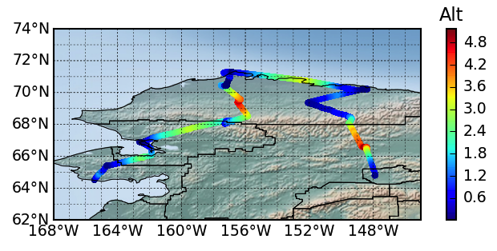
9 June 2017/DOY 160 Nome – North Slope – Fairbanks
Flight Plan:
Nome – Ivotuk – Atqasuk – Barrow – Deadhorse – Umiat – Toolik Lake – Fairbanks
Barrow
Deadhorse
Atqasuk
Umiat
Ivotuk
Toolik
Kotzebue
Fairbanks
Nome

Slide 5
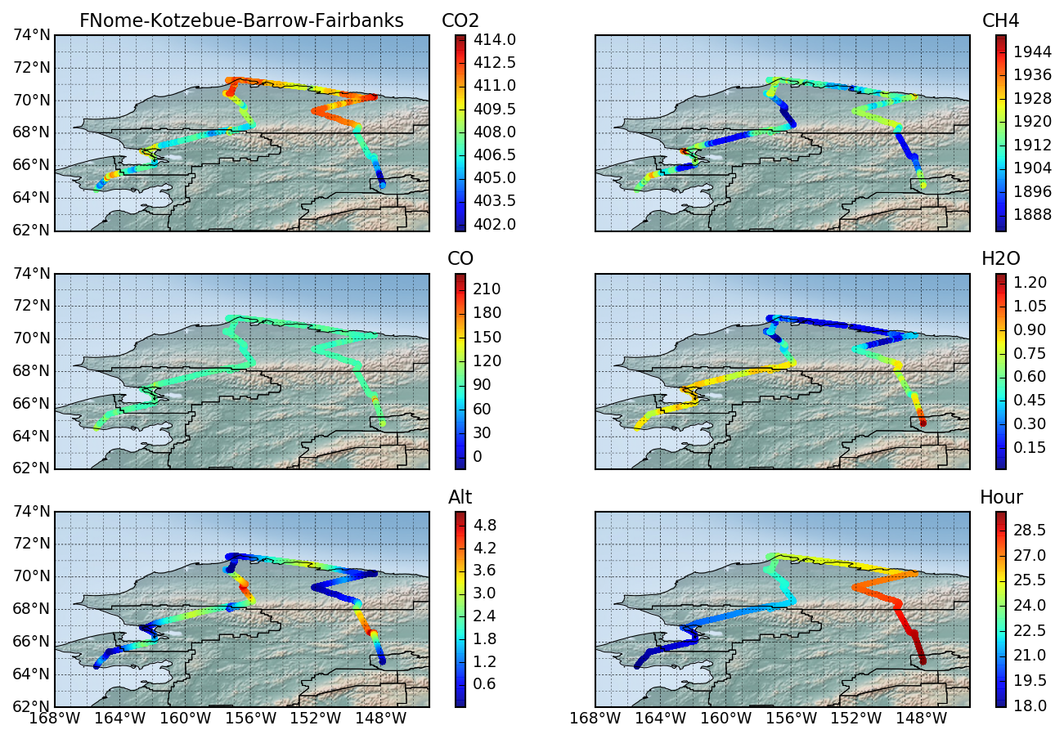
1 May 2017/DOY 122 Nome – North Slope – Fairbanks
Notes:
CO2: Note systematic CO2 uptake south of the Brooks Range, and systematic CO2 emissions over the North Slope
CH4 shows small to moderate enhancements for all near surface flight segments
CO at background levels everywhere, all altitudes
H2O low over North Slope, high south of the Brooks Range, consistent with altitude and surface temperature

Slide 6
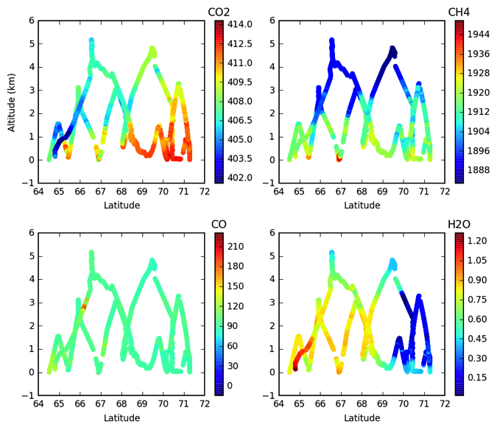
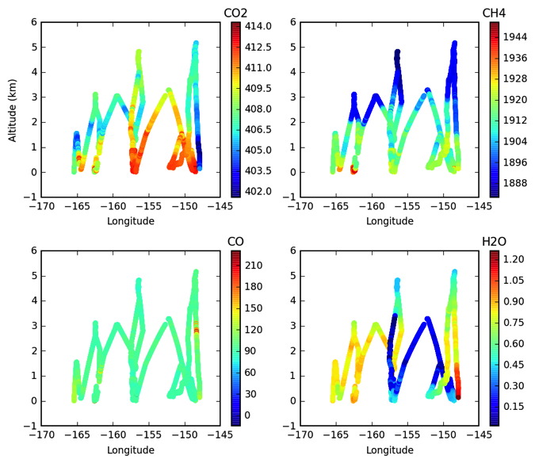
6 June 2017/DOY 157 Yellowknife – Daring Lake – Inuvik
CO2, CH4, CO, H2O profiles vs altitude and latitude (left) and longitude (right)
+4-6 ppm CO2 near surface (Z < 2 km) CO2 enhancements north of 68 N, -0-2 ppm CO2 depletions south of 68 N
+10-30 ppb CH4 enhancements observed at all locations for Z < 2 km
Notes:
CO2 and CH4 enhancements observed up to Z ~ 3 km north of 70 N, but near surface behavior seen only to Z ~ 1-2 km south of 70 N

Slide 7
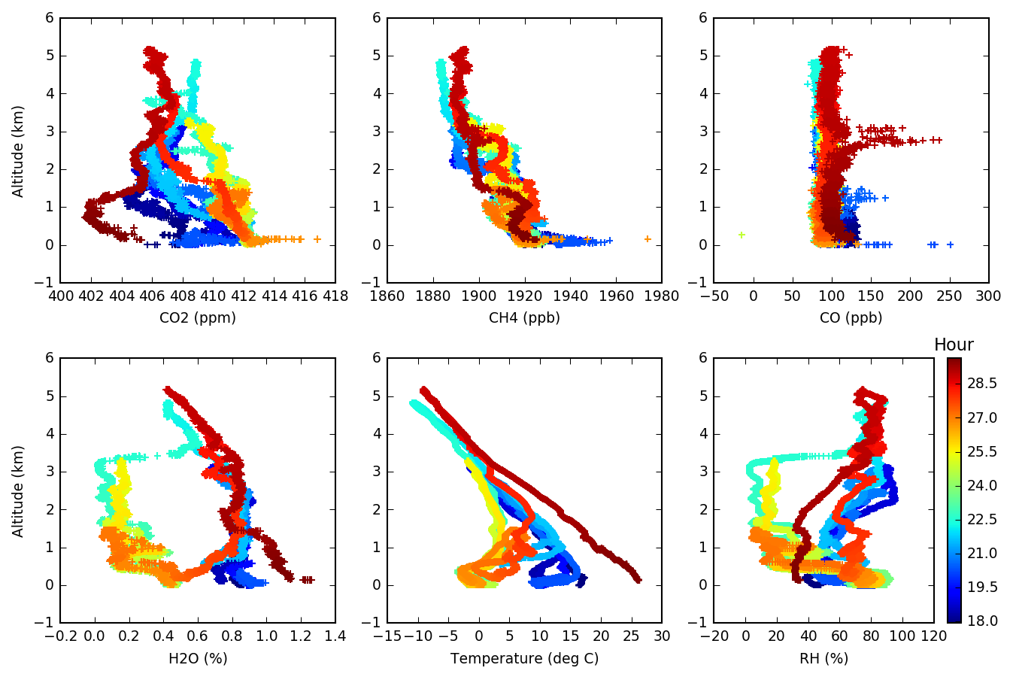
1 May 2017/DOY 122 Nome – North Slope – Fairbanks
Notes:
CO2 Profiles show near surface CO2 depletions at Fairbanks (red) and Nome (dark blue) but enhancements all North Slope sites
CH4 profiles show 10-30 ppb CH4 enhancements for z < 1 km
H2O < 0.4% for North Slope near surface; H2O > 0.8% south of the Brooks Range

Slide 8
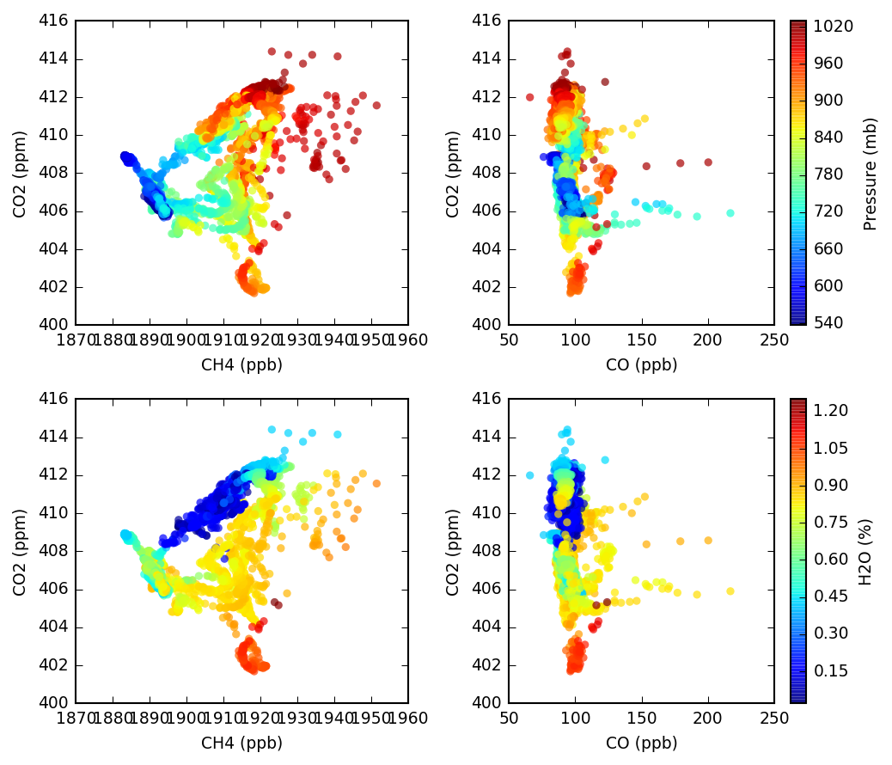
9 June 2017/DOY 160 Nome – North Slope – Fairbanks
CO2 v CH4 and CO2 v CO tracer-tracer correlation plots with colors showing pressure altitude (top) and H2O (bottom)
Near surface CO2 v CH4 show evidence of both C release and C uptake
Largest CO2 depletions correlate with H2O > 0.70%
Largest CH4 enhancements tied less strongly to max H2O
Notes:
The vertical distribution of CO2 levels spanning almost 15 ppm shows the varied range of ecosystem dynamics at work during the spring transition period.
Note that the highest observed CH4 concentrations correlate with the CO2 enhancements (ie the North Slope)

